Slide 1
Dallas, Texas 2016
RRCA Convention
Highlights
Presenters:
Joy Schoenecker and Ron Alford
April 12, 2016

Slide 2
Presenters
Ron Alford
RRCA Hawaii State Representative
And
Joy Schoenecker
Mid-Pacific Road Runners Club President

Slide 3
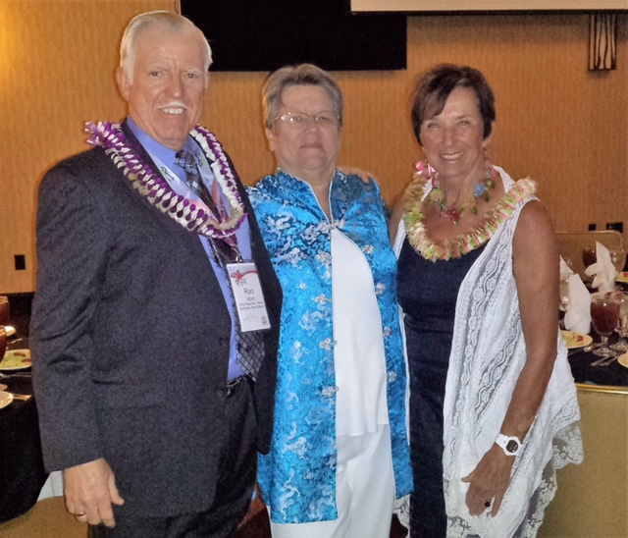

Slide 4
Ron Alford
RRCA Hawaii State Representative
RRCA Convention Notes
Dallas, Texas
2016

Slide 5
TOPICS OF DISCUSSION
RRCA Roadie Program
Building Community through Fitness
Developing Engaging Training Programs
Developing A City-wide Running Club
Active.com – Membership Tools

Slide 6
1. RRCA ROADIE PROGRAM
Goal: Increase visibility and awareness of the RRCA by engaging runners will and interested in promoting our
“Join a Club” message. The “Roadie” program strives to enlist additional RRCA “ambassadors” – youthful, outgoing runners who will promote RRCA at events and on social media
Roadies are:
Runners
Outreach
Ambassadors
Dedicated
Involved
Enthusiastic

Slide 7
1. RRCA ROADIE PROGRAM – Cont’d
Roadies will receive and be asked to wear an RRCA shirt to events of any distance, training runs, and social gatherings.
Roadies will encourage people to join their local club
and run in local races.
Roadies will be expected to be active on social media and share photos on Facebook, Twitter, or Instagram using the #RRCAontheRoad hashtag.

Slide 8
2. Building Community through Fitness

Slide 9
2. Building Community through Fitness
Promoted “Meet Me” Events in a particular location. Run or walk up to 4 miles.
Gave awards and prizes for coming a certain number of times. Talked with local police – stay on the sidewalk, obey traffic laws = no permit needed.
Worked with local businesses, particularly restaurants for discounts to participants.
Promotion of program via word of mouth, website, newsletter, Facebook, local media (unrequested), and neighborhood associations.
Also had a “trash” night where walkers would pick up trash in the area.

Slide 10
3. Developing Engaging Training Programs

Slide 11
3. Developing Engaging Training Programs
Looked at:
People – Admin and participants
Structure – Groups and sessions (when: morning, evening, weekend/ where: public, private, municipal)
Goals – Club income or community outreach, distance race training or social (know your market)
Programs reviewed three (3) clubs:
1. Dallas Running Club (3000 members). Train by season, club members only, charge to members to generate income for the club. Volunteers: Admin = 2, Coaches = 12, Pace Leaders = 70, Water Handlers = 2.

Slide 12
3. Developing Engaging Training Programs – Cont’d
2. Annapolis Striders. Seasonal Training included in membership. Use city parks so charges for permits. Give out hats or shirts to participants or make it optional to buy.
Training program elements:
Volunteer Engagement – Coaches = good at motivation, sense of purpose. Pace Leaders = mentors, front line of the program, should carry a sense of status (have application process – must work for it)
Participant Engagement – Positive experience (goal oriented or social), Fun/Social atmosphere (have both running and social events), provide learning opportunities on becoming a better runner.

Slide 13
4. Developing a City-wide Running Club
3. Atlanta Track Club - Developed a vision statement and a values statement to guide the club. They have events training, and elite team, and youth training.
Kilometer kids – free to schools and kids, 11 weeks of training, run26.2 miles over time with the final event together.
Lots of volunteer recognition – have green vests for all volunteers
Sponsors include all local running stores (even though competitors, there are enough runners to go around)
Better branding – use consistent recognizable logos and marketing.

Slide 14
5. Active.com –Membership Tool
Active.com now has a tool for managing Club Memberships
This might benefit MPRRC in:
A. Determining who is a member of the club
B. What membership designation they currently hold
C. Eliminating extra work for Sam and Tammy
C. Provide accurate and current membership
information for Joan –who can pull bibs for
undocumented members

Slide 15
Please save your questions until the
end of this presentation.
Thank you !

Slide 16
Joy Schoenecker
MPRRC Club President
RRCA Convention Major Topics
Dallas, Texas
2016

Slide 17
Six Major Topics
2
3
1
BUDGET
Financial Management
^{SAFETY}
5
6
4
PAID
RACE
DIRECTOR
COMMUNICATION
VOLUNTEERS

Slide 18
Safety
1

Slide 19
1. Safety
A Race Day emergency plan
Consider CPR for all Board Members
Course Map presented for each race

Slide 20
Budget
2

Slide 21
2. Budget
Board Treasurer make a Budget
Using last 2 years - project revenue and expenses for all upcoming races
Work within a Budget for each race
Treasurer should not be only one reviewing revenue and expenses every month.
Is Budget consistent with mission?
501(c)3 organizations can have as much money as it wants in account – no limit
Keep a substantial Reserve in your account

Slide 22
FINANCIAL MANAGEMENT
3

Slide 23
3. Financial Management
A. Packet Pickup and Race Day entries – Cash Box
a. Initiate Cash Free Sign ups for all races
b. Use only check or credit card
-- Some tools include- the Square, Quicken on a laptop or iPad, etc.
and RRCA has several ideas
Note: MPRRC has a Square for our use

Slide 24
Volunteers
4

Slide 25
4. Volunteers
Recognition
--Must not be Cash
Consider a Volunteer Tee Shirts, or Vest
B. Mentoring – Use past club officers to help mentor newbies and offer suggestions.

Slide 26
Communication I. Personal and II. Technology -Website
5

Slide 27
5. COMMUNICATION --
I. Personal –
A. Nothing reaches a person more than a personal conversation—
For example: an accolade – encouragement – feeling wanted and valued, etc.
B. Cheering at the finish line -- is a great way to communicate at your races

Slide 28
5. COMMUNICATION -
II. Technology - website
A. Be transparent to your membership.
B. Post all pertinent documents on club website
Examples:
By-Laws and Constitution
Names of Board Members
Minutes of each Meeting BUT-- remove all
names and only post after approved by BOD.
Basis for Annual awards should be stated according to By-laws
Upcoming races - Post our Race Schedule
Upcoming meetings – Our meetings have a set date
C. Use tools for posting instant information on club website, and use twitter, Facebook, etc.,
D. Millennials want instant feedback – pictures, results, etc.

Slide 29
PAID Race Director
6

Slide 30
6. Paid Race Director
A. First criterion is –The size of your race
a. Should be more than 500 entrants
b. A ‘Paid Race Director’ has ALL the
responsibilities of a race, including but not limited to—
A Written Contract (A RFP)
A Budget
Time lines on all pertinent items
Sponsorships
Awards
Permits
Sub-contractors – coning, police, etc.

Slide 31
2017 RRCA CONVENTION --- Detroit !!!!!!
Are there any Questions?
Thank you for your attention !
Joy and Ron

